Slide 1
Algorithm for Implementation of a Fuzzy System

Slide 2
Algorithm
Step 1: Get the number of input variables for your system as well as the range of each input variable and the output variable
Step 2: Normalize each variable between -1 to +1 linearly (ideally) using where x_{i} and X_{i} are the original and normalized variables for variable i, and u_{i} and l_{i} are corresponding upper and lower bounds
Step 3: Decide on the number of fuzzy sets that you will use to granulate each input as well as the output
Step 4: Decide on the type and distribution of fuzzy sets for each input and output variable, i.e. centroid and span (boundaries)
Step 5: Formulate the Fuzzy Associative Matrix (FAM : also called Fuzzy Inference Engine)

Slide 3
Algorithm (cont’d)
Step 6: Given a crisp input vector (numbers), first, fuzzify all variables; i.e. decide on degree of belonging of each var to each fuzzy set spanning the range of that var
Step 7: Calculate the degree of activation of each cell of the FAM by the product rule
Step 8: Defuzzify to obtain the crisp output:
where w_{k} is the weight, i.e. degree of activation, of cell k where k is the single running variable over all cells
k ∈ {1, 2, ..N}; ; m_{i} is granulation level of input variable i
C_{k} is the centroid of cell k.

Slide 4
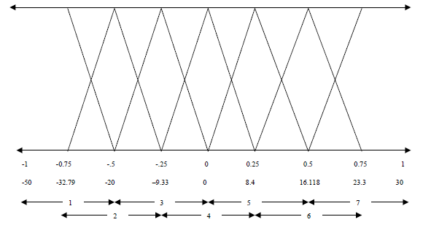
Typical Fuzzy Set (MF) Distributions

Slide 5
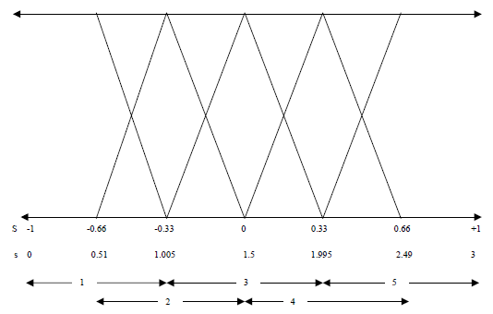
Typical Fuzzy Set (MF) Distributions

Slide 6
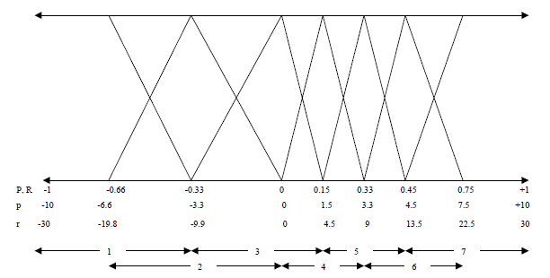
Typical Fuzzy Set (MF) Distributions: Finer in regions where sensitivity of output to input is higher

Slide 7
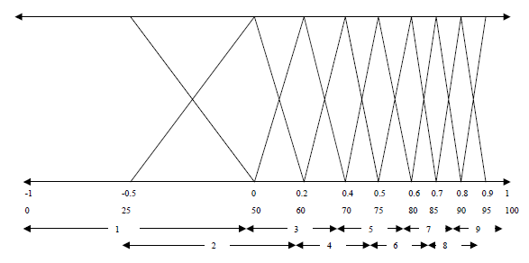
Typical Fuzzy Set (MF) Distributions (Output)

Slide 8
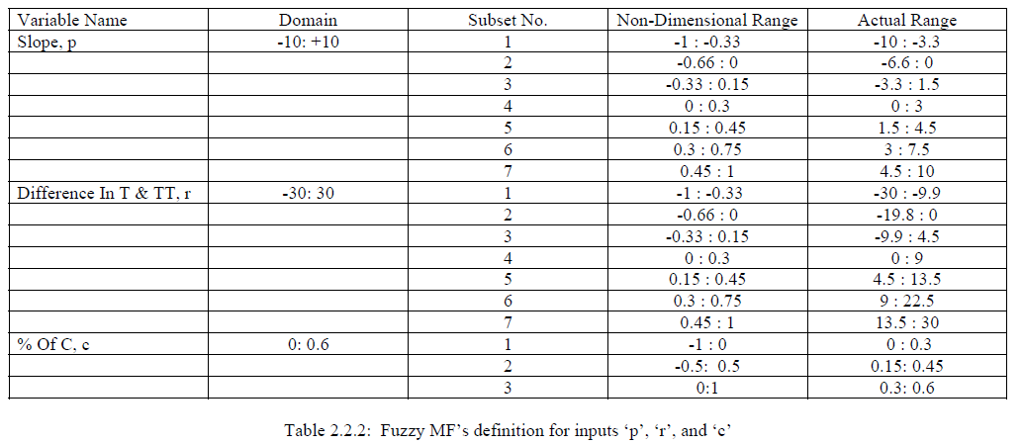
Documentation of input fuzzification

Slide 9
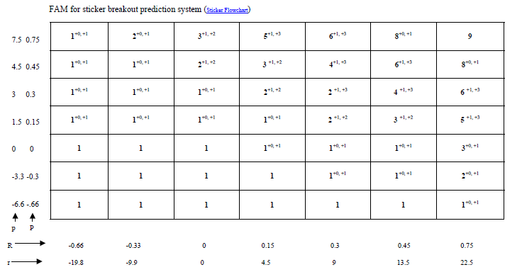
FAM for a 3-input system: 2 primary, 1 secondary (next slide explains how a 2-D FAM accommodates the 3rd input var)

Slide 10
Explanation of how a 2-D FAM accommodates the 3rd input var
The third input var is composed of only 3 fuzzy sets
The base values in the FAM (previous slide) denote the value of the output fuzzy set activated when the 3rd var is in its first fuzzy set
The two indices with a plus are not strictly indices, they are the value by which the base value is to be incremented to provide the activated output fuzzy set when the 3rd var is in its 2nd or 3rd fuzzy set
You may notice that the total never adds up to more than 9, the total number of output fuzzy sets.

